Slide 1


Data analysis skills Group project2
Group13
Kuan Wang, Jinhan Meng, Yijun Zhou, Xuhong Jin, Ziyan Shang

Slide 2
Introduction to dataset
Comes from the Coffee Quality Database (CQD).
Variables including:
Main question:
What features have an impact on the quality of coffee?
Origin country
Aroma
Flavour
Acidity
Count of defects
Mean attitude of grower farm
Year of harvested
Quality class

Slide 3
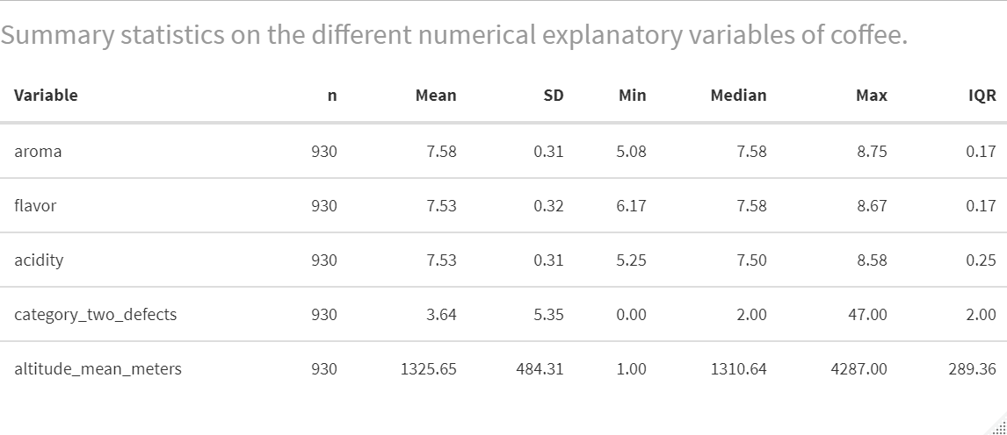
Data Wrangling and Pre-processing
Removing missing data and extreme values
Processing non-numerical data
Table shows that the mean values of Aroma grade, Flavor grade and Acidity grade are both approximately 7.5. There are large differences of category two defects between different coffee beans, as some have no defective product, but some have 47 in the batch of coffee beans tested. Similarly, the difference in mean altitude is distinct.

Slide 4
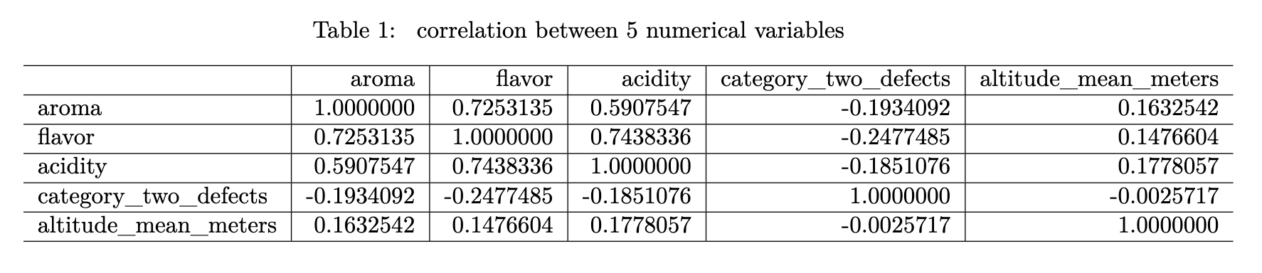

Calculating correlation
strong positive correlation: aroma~flavor(0.725); flavor~acidity(0.744)
moderate positive correlation: aroma~acidity(0.591)
Others are weak.

Slide 5
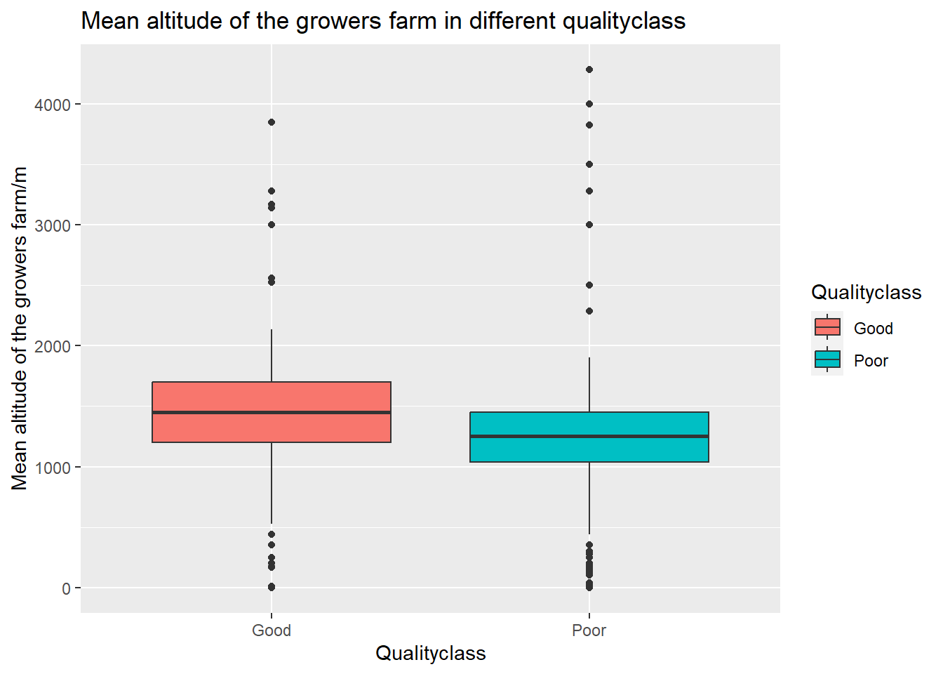
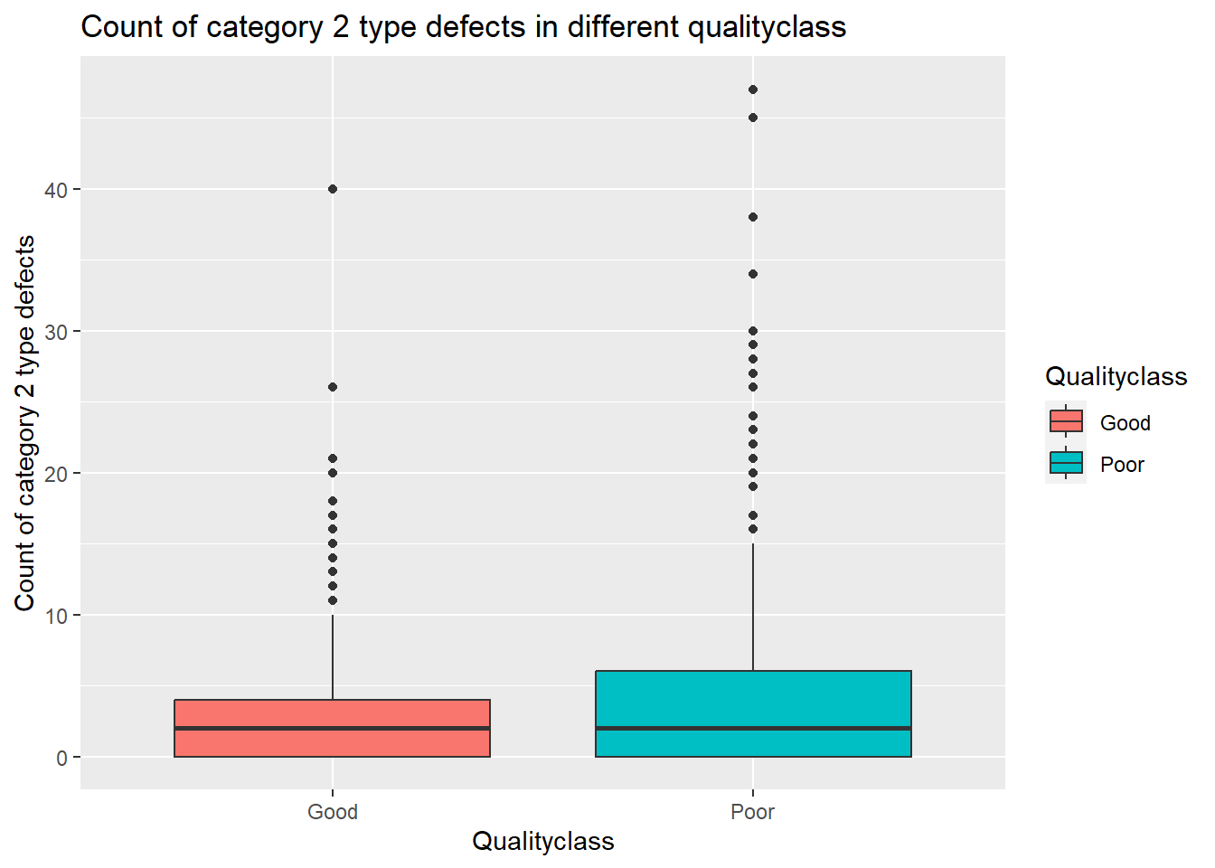
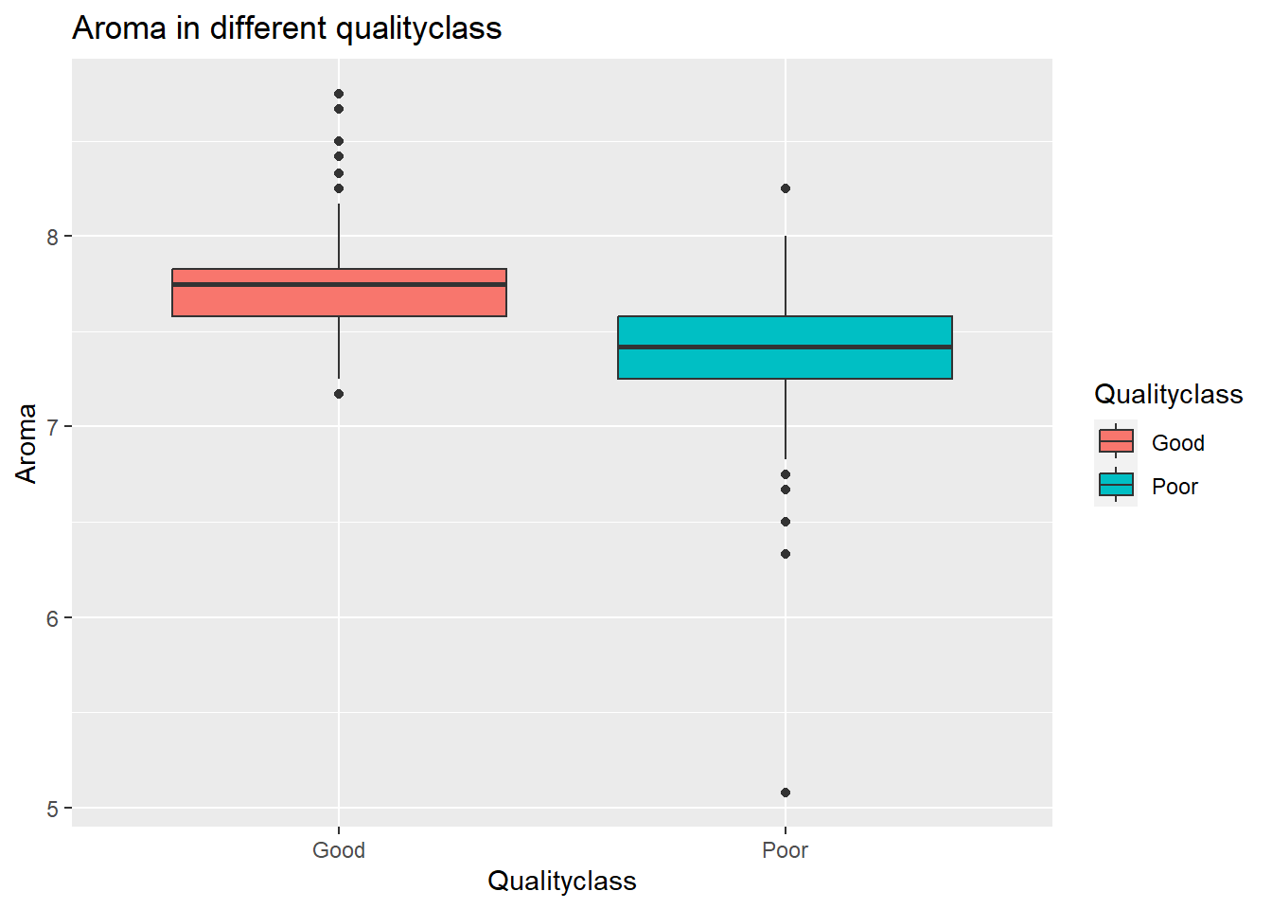
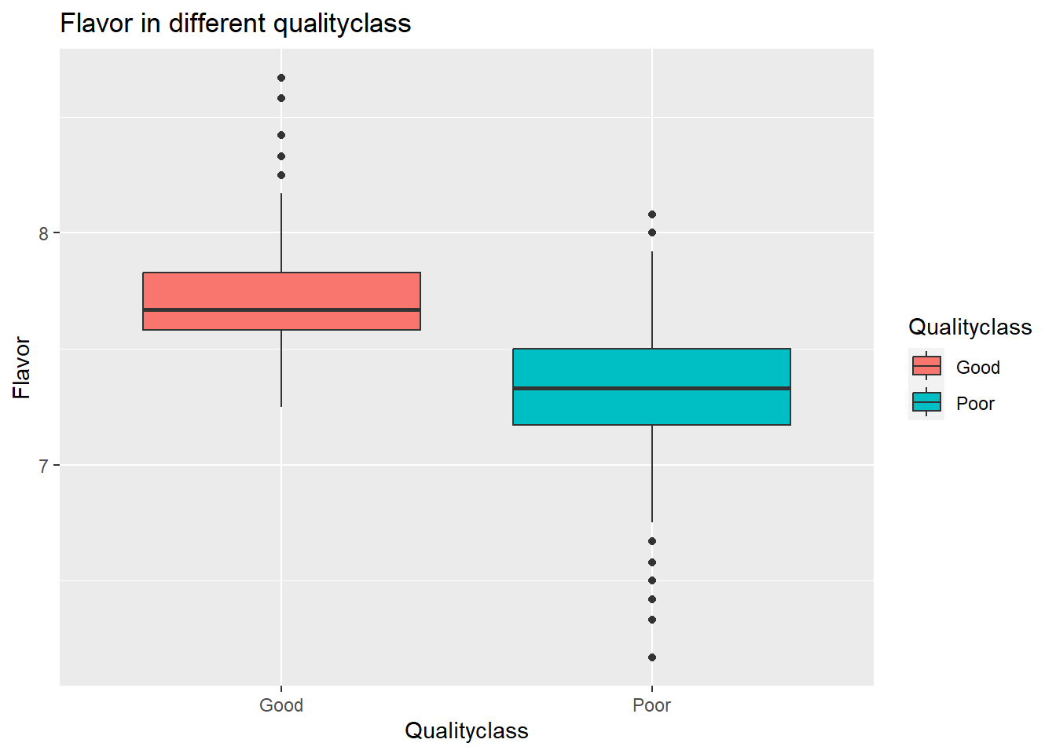


Slide 6
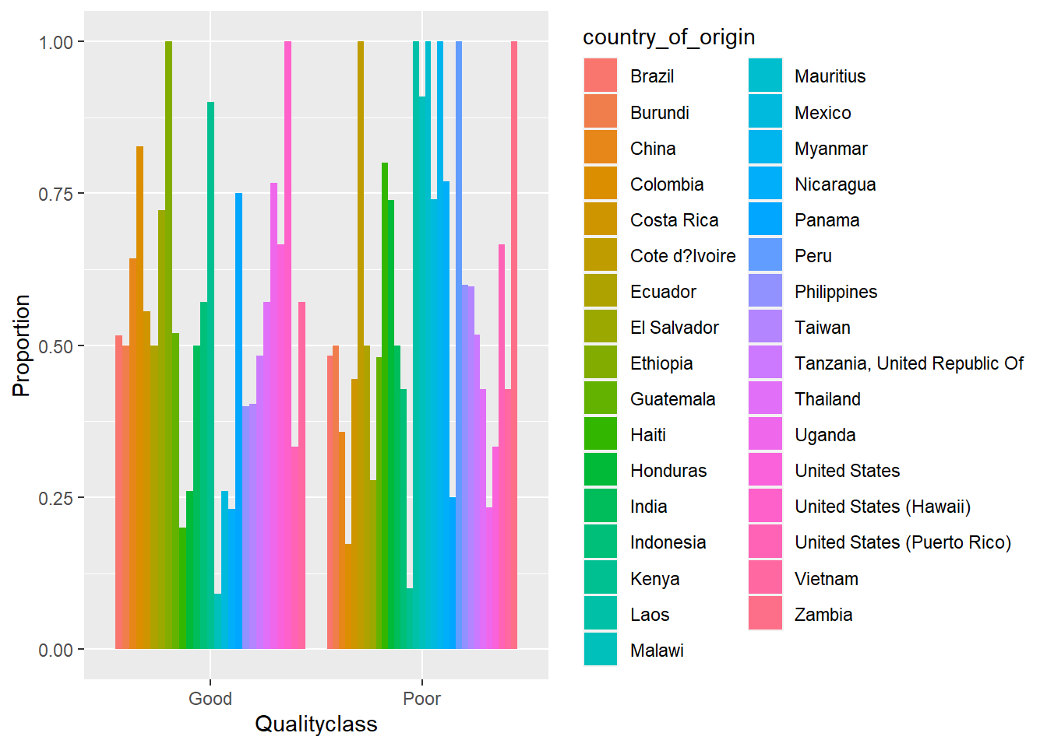
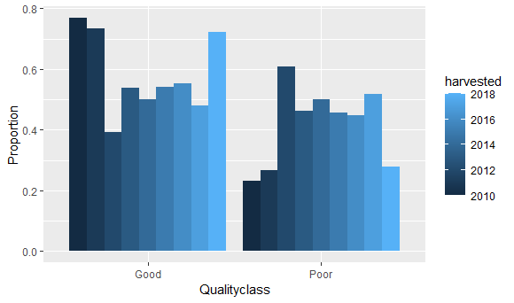
Chart: Qualityclass propotion by country
Chart: Qualityclass propotion by harvested year

Slide 7
Formal data analysis
We use GLM (Generalized Linear Models) to study the multi-factor problem of coffee bean quality because:
GLM can consider the impact of multiple independent variables on the response variable, and through parameter estimation, determine the degree and direction of each factor's influence on coffee bean quality.
It can handle different types of response variables: GLM can handle binary response variables (Qualityclass: Good/Poor), as well as continuous or count response variables (aroma/flavor/acidity).
It can handle non-normal distributions: GLM can use different link functions to handle non-normal distributions of response variables, such as binomial link functions, Poisson link functions, etc.
It is easy to interpret and explain results: GLM can output statistical indicators such as parameter estimates, standard errors, and confidence intervals, allowing us to accurately interpret the results of the model and the degree and direction of each factor's influence on coffee bean quality.

Slide 8
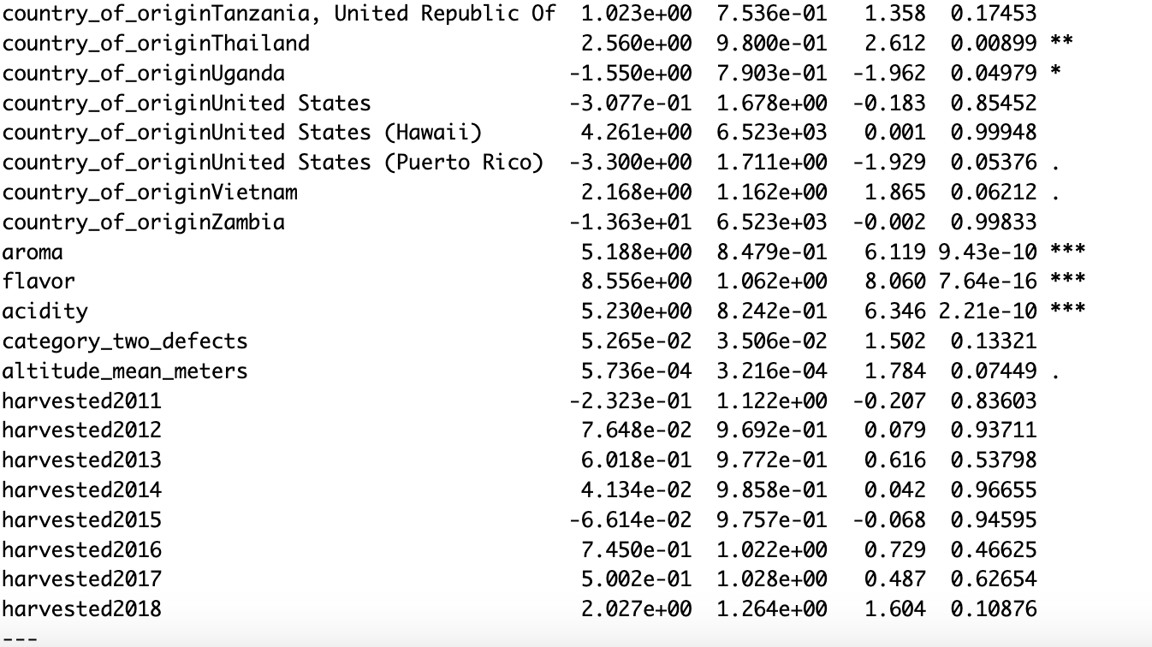





Basic GLM model
Aroma, flavor and acidity has coefficients of 5.19, 8.56, 5,23 separately, strong positive influence on cafe quality.
Country_of_origin: Highest: Ethiopia (13.33), Countries with coefficients below -10: Cote d’Ivoire, Laos etc. Countries that have p values<0.05: Thailand, Uganda etc.
AIC = 543.7

Slide 9
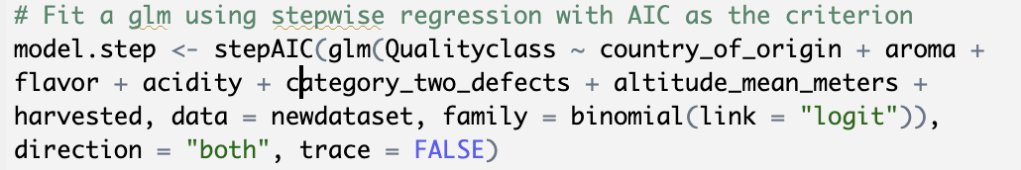
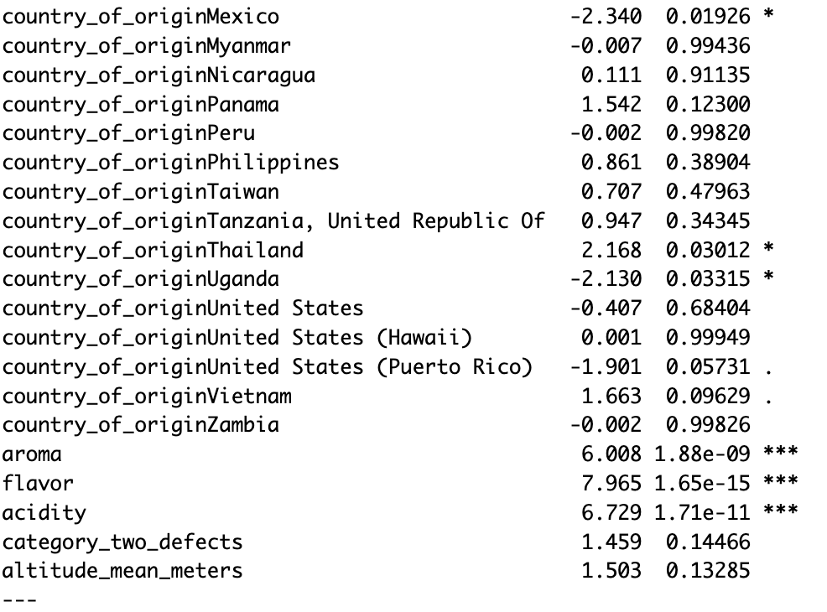
GLM stepwise
Use the stepwise GLM to help us improve the model
AIC = 537.7

Slide 10
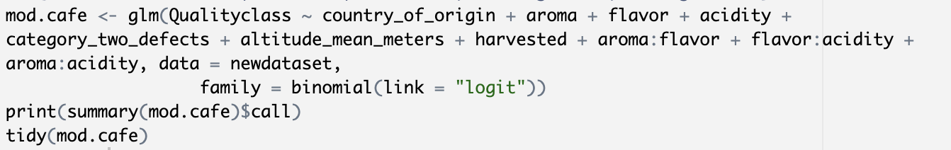
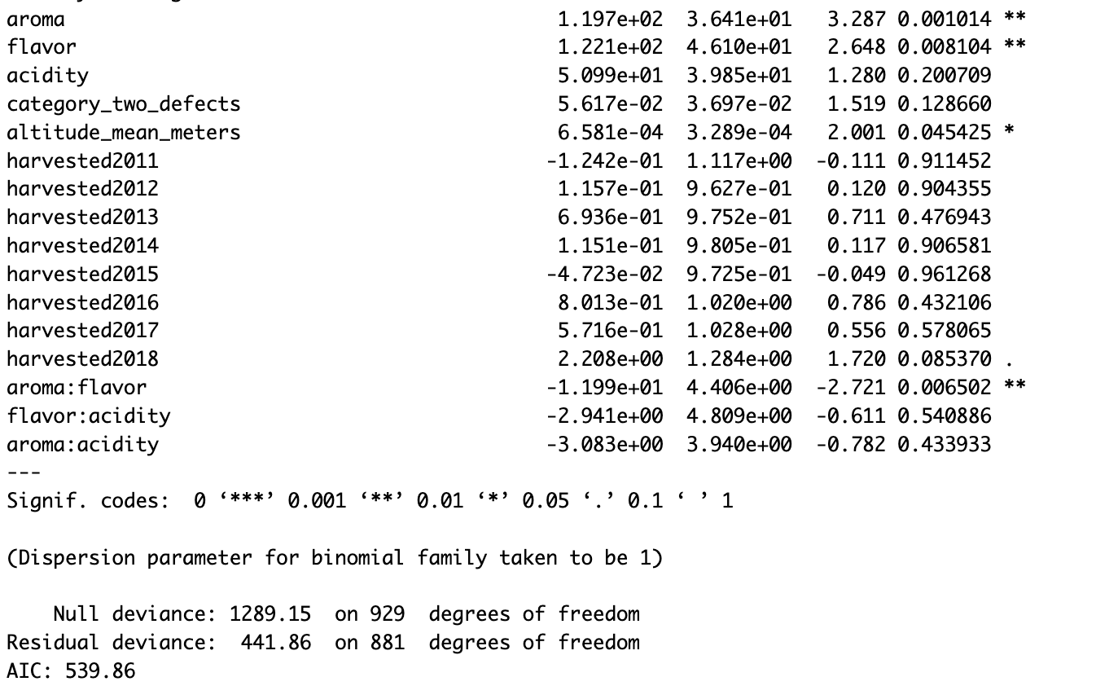
Adding interaction terms
Added some interaction terms(aroma:flavor, flavor:acidity, aroma:acidity).
The coefficients of all our possible interaction terms are negative, these three variables may moderate each other.
AIC = 539.9
The interaction terms improved our model.

Slide 11
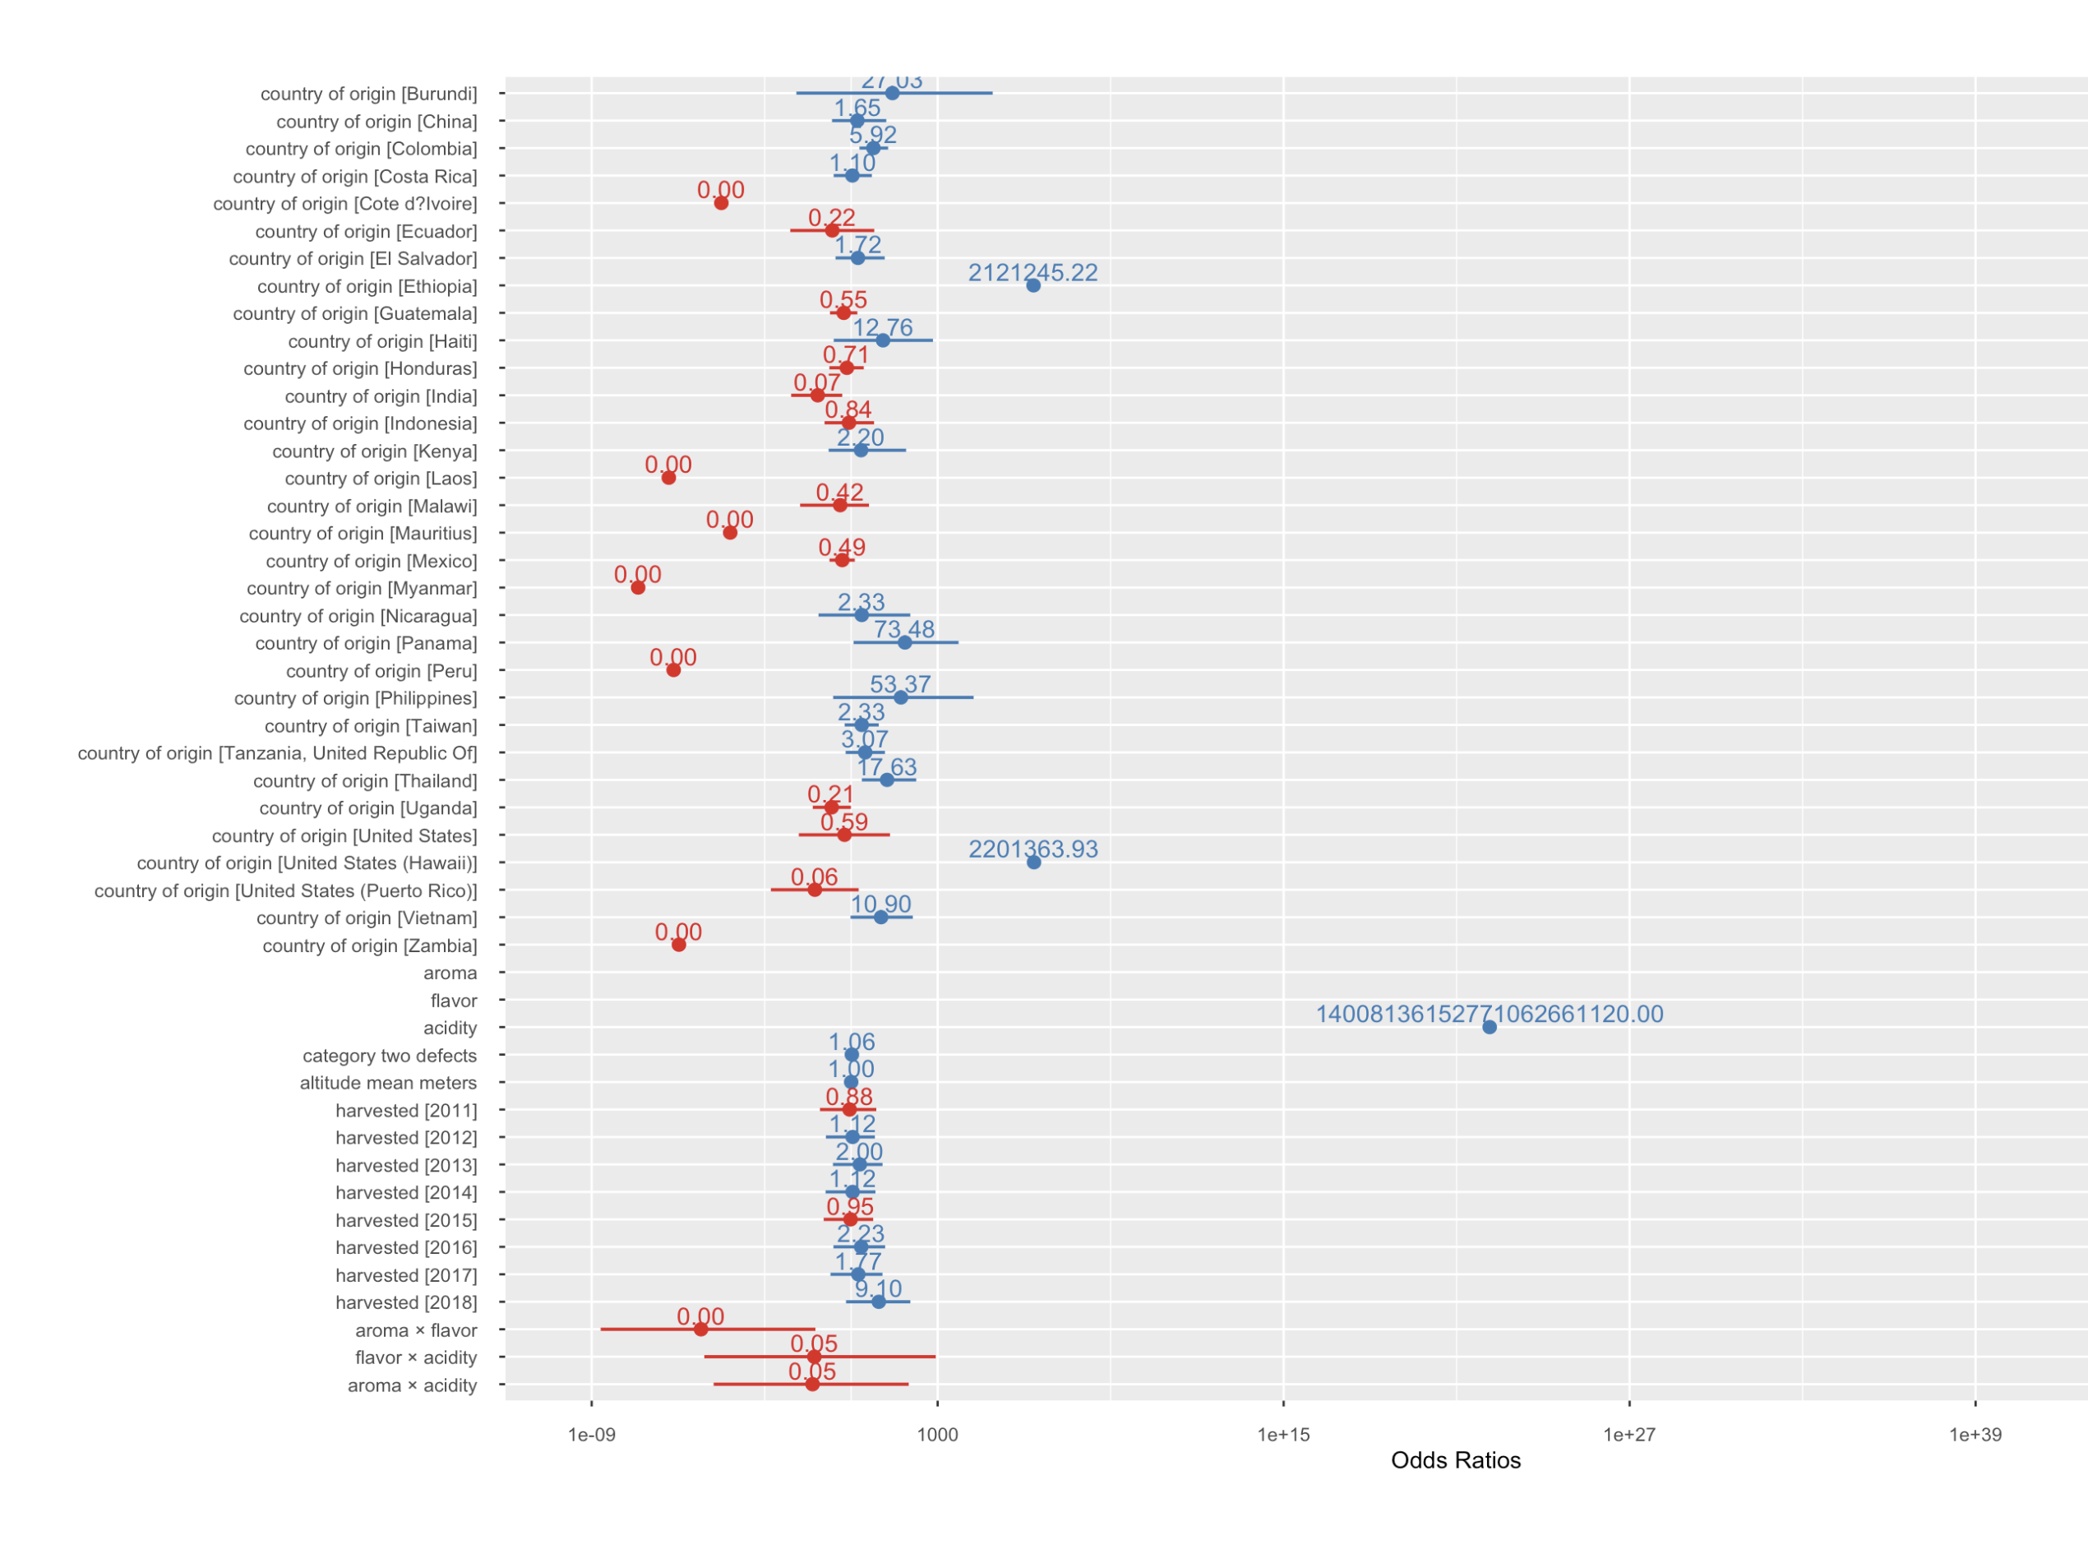
Adding interaction terms
The results of log-odds and their corresponding 95% confidence intervals.

Slide 12
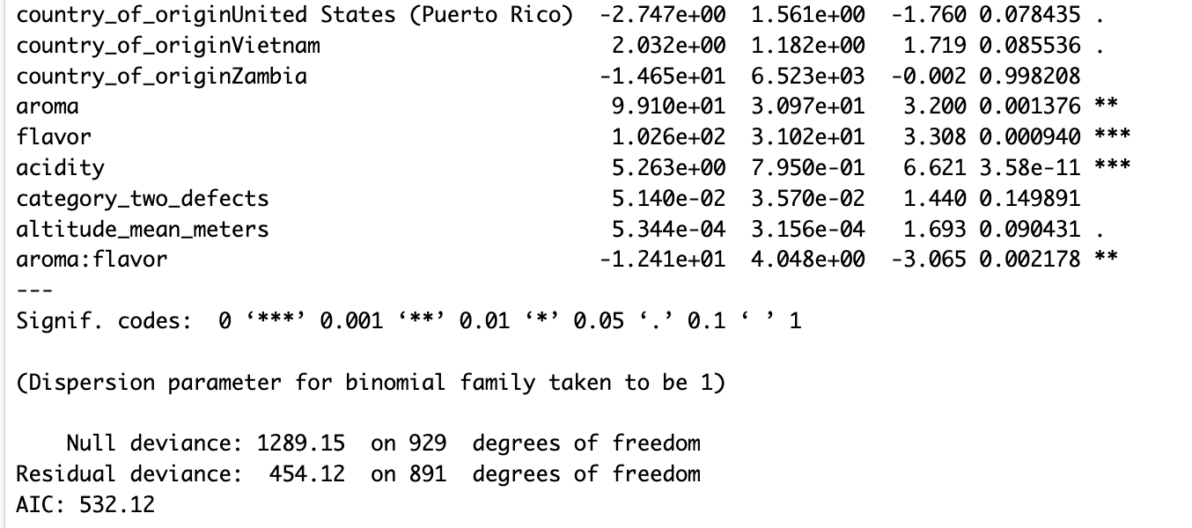
GLM stepwise with Interaction terms
AIC = 532.1
AIC decreased to the lowest among these four models we fitted.
This model has the lowest BIC=720, while the other three are 766,721,776 separately

Slide 13
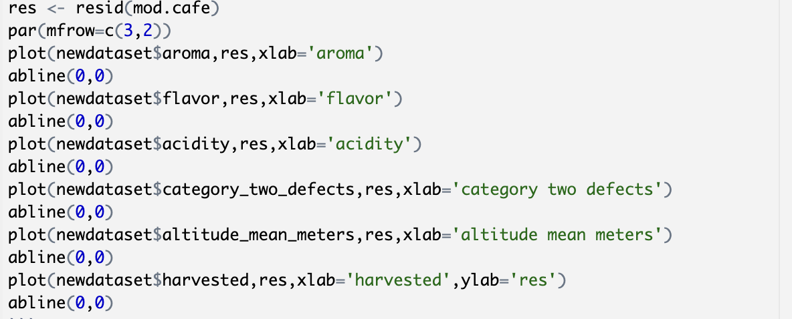
Checking assumptions
Residuals Plots for each variables

Slide 14
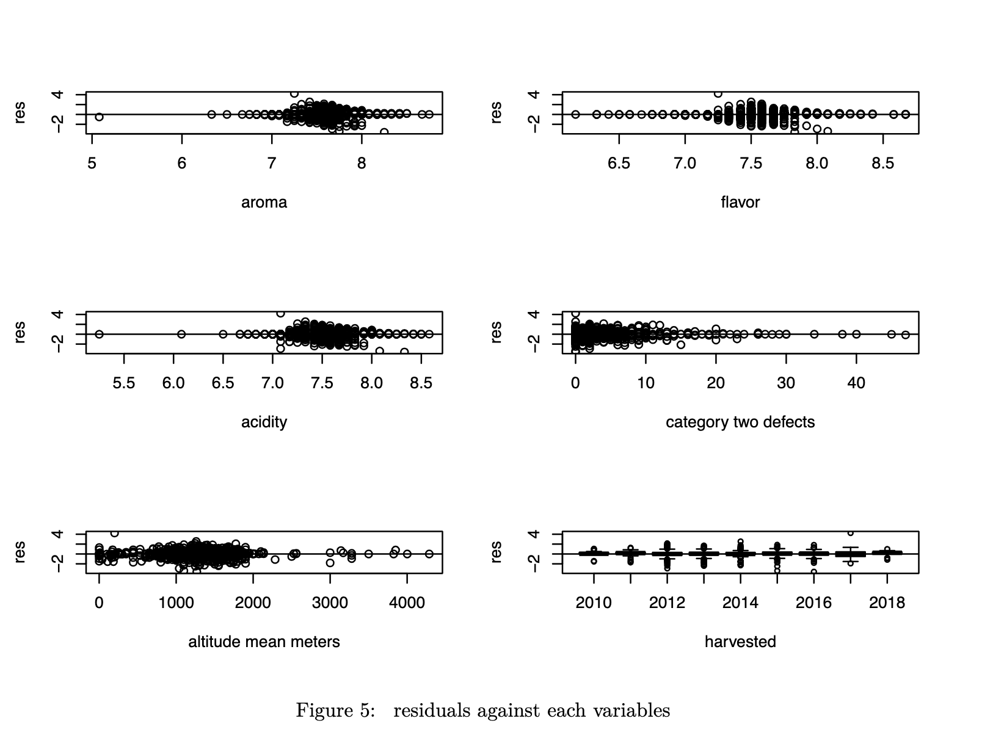
Residuals Plots for each variables
There is an even spread of the residuals for each variable, very few outlier points.
Assumption that the residuals have mean zero appears valid.

Slide 15
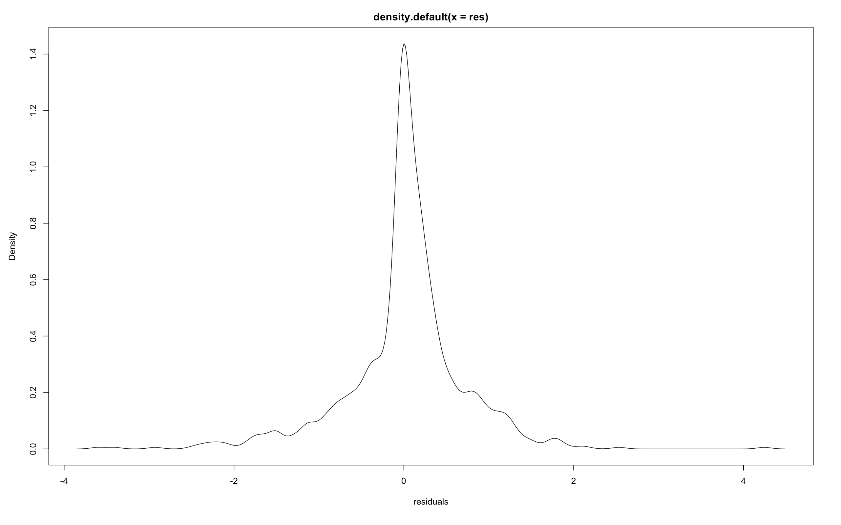
Residuals Plots for each variables
The residuals are normally distributed with the mean 0, therefore the assumption is valid.
The remaining assumptions hold, thus our model appears valid.

Slide 16
Conclusion
GLM stepwise with interaction terms: (aroma:flavor, flavor:acidity, aroma:acidity) is the best fitted model with lowest AIC and BIC
Aroma, Flavor and acidity are the main contributors to the quality of coffee
Interaction of Aroma and flavor will do negative effect in coffee quality
Columbia, Thailand have better coffee farming conditions
Uganda, India, Mexico have worse coffee farming conditions

Slide 17

Thank you for your time!

